Slide 1
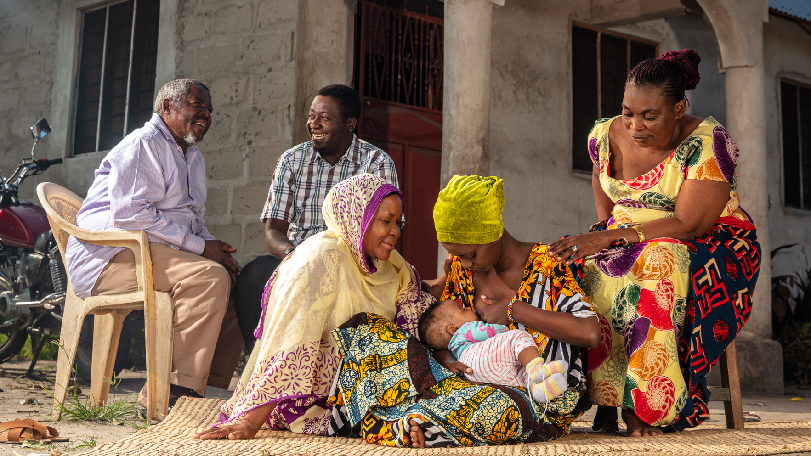

FINAL
CAMPAIGN MATERIALS- RADIO SPOTS

Slide 2
Spot 1: Grandma on EBF
Swahili
English
BUSARA’S MOM
For sure, your child is our child.
In my baby Busara’s first six months, her grandmother ensured that I only breastfed her on demand (Baby Cries) I remember she said…
Grandmother:
The more you breastfeed her, your breasts respond by making more milk to satisfy her need.
END VO: When the baby is happy, we are all happy. To learn more call *199# FREE
This message is brought to you by Ministry of Health in collaboration with UNICEF, SADC and GAIN
MAMA BUSARA:
Kweli mtoto wako ni wetu sote.
Miezi sita ya mwanzo ya mwanangu Busara, bibi yake alihakikisha namnyonyesha maziwa ya mama pekee kila mualipohitaji (Baby Cries) Nakumbuka Alisema…
BIBI:
Kadri unavyomnyonyesha, ndivyo maziwa yanavyotengenezwa kwa wingi kwa ajili ya mtoto.
END VO: Ndio, Mtoto akifurahi, tunafurahi. Tushiriki kumlea. Kufahamu zaidi piga simu nambari*199# BURE
Ujumbe huu umeletwa kwenu na Wizara ya Afya kwa kushirikiana na wadau wa UNICEF, SADC na GAIN

Slide 3
Spot 2: Aunt on EBF
Swahili
English
MAMA BUSARA:
Kweli mtoto wako ni wetu sote.
Mwanangu Busara alipofika miezi minne nilitaka kumuanzisha uji (baby crying in background) Shangazi yake akanielimisha…..
SHANGAZI:
hapana usimpe hata maji, (baby chuckles) maziwa yako pekee yanamtosha.
unapaswa kufanya hili kwa miezi 6 ya mwanzo mpe maziwa ya mama pekee, usimpe kitu kingine chochote
END VO: Ndio, Mtoto akifurahi, tunafurahi. Tushiriki kumlea. Kufahamu zaidi piga simu nambari*199# BURE
Ujumbe huu umeletwa kwenu na Wizara ya Afya kwa kushirikiana na wadau wa UNICEF, SADC na GAIN
BUSARA’S MOM:
your child is our child.
When Busara was four months old, I had planned to introduce her to porridge (baby crying in the background). But her aunty educated me…
Aunty:
No no no do not even give drinking water, (baby chuckles), Breastmilk is enough, you should do this in the first six months, breastfeeding only, nothing else.
END VO: When the baby is happy, we are all happy. To learn more call *199# FREE
This message is brought to you by Ministry of Health in collaboration with UNICEF, SADC and GAIN

Slide 4

Spot 3: Dad and mashed food (30 seconds)
IMPLEMENTATION PHASE
Swahili
English
MAMA BUSARA:
Kweli Mtoto wako ni wetu sote,
Busara alipofika miezi 6 baba yake alijitoa sana (baby chuckles in background) Mbali na kulemletea busara nyama, dagaa, mayai na maziwa alinisaidia pia kumpondeapondea chakula kiwe laini ili aweze kula kwa urahisi. Na aliniambia…..
BABA:
Mtoto wetu ametimiza miezi 6, tuanze kumpa mlo kamili huku akiendelea kunyonya hadi atakapofika umri wa miaka miwili au zaidi.
END VO: Ndio, Mtoto akifurahi, tunafurahi. Tushiriki kumlea. Kufahamu zaidi piga simu nambari*199# BURE
Ujumbe huu umeletwa kwenu na Wizara ya Afya kwa kushirikiana na wadau wa UNICEF, SADC na GAIN
BUSARA’S MOM:
For sure, your child is our child,
When BUSARA was half a year old, her Dad was fully dedicated to fatherhood. Besides coming home with meat, sardine, eggs and milk for Busara, he’d also help me to mash her meal till it was very soft to feed. And he always told me that……
BUSARA’S DAD:
Our baby is 6months old, let’s start giving her balanced diet while you continue breastfeeding until she reaches 2 years or above..
END VO: When the baby is happy, we are all happy. To learn more call *199# FREE
This message is brought to you by Ministry of Health in collaboration with UNICEF, SADC and GAIN

Slide 5
IMPLEMENTATION PHASE
Spot 4: Grandpa on Snacking (30 seconds)
Swahili
English
MAMA BUSARA:
Kweli Mtoto wako ni wetu sote,
Tulipomuanzishia Busara busara chakula cha nyongeza ilibidi tumbadilishie milo tofauti tofauti (sound of baby eating) Ila babu yake alipokuja alipenda sana kumletea matunda kama vile papai, embe ndizi mbivu; na kuniambia….
BABU:
Katika umri huu wa miezi 6 hadi miaka miwili, mpe mjukuu wangu mlo kamili huku ukiendelea kumyonyesha.
END VO: Ndio, Mtoto akifurahi, tunafurahi. Tushiriki kumlea. Kufahamu zaidi piga simu nambari*199# BURE
Ujumbe huu umeletwa kwenu na Wizara ya Afya kwa kushirikiana na wadau wa UNICEF, SADC na GAIN
BUSARA’S MOM:
For sure, your child is our child,
When we started giving Busara complementary food, we had we had to give her variety of food (sound of baby eating). When her grandfather came, he always brought his granddaughter fruit such as pawpaw, mango, ripe banana, and told me……
BUSARA’S DAD:
At this age of 6 months to two years, give my granddaughter balanced diet while you continue breastfeeding until she reaches 2 years or above.
END VO: When the baby is happy, we are all happy. To learn more call *199# FREE
This message is brought to you by Ministry of Health in collaboration with UNICEF, SADC and GAIN

