Slide 1
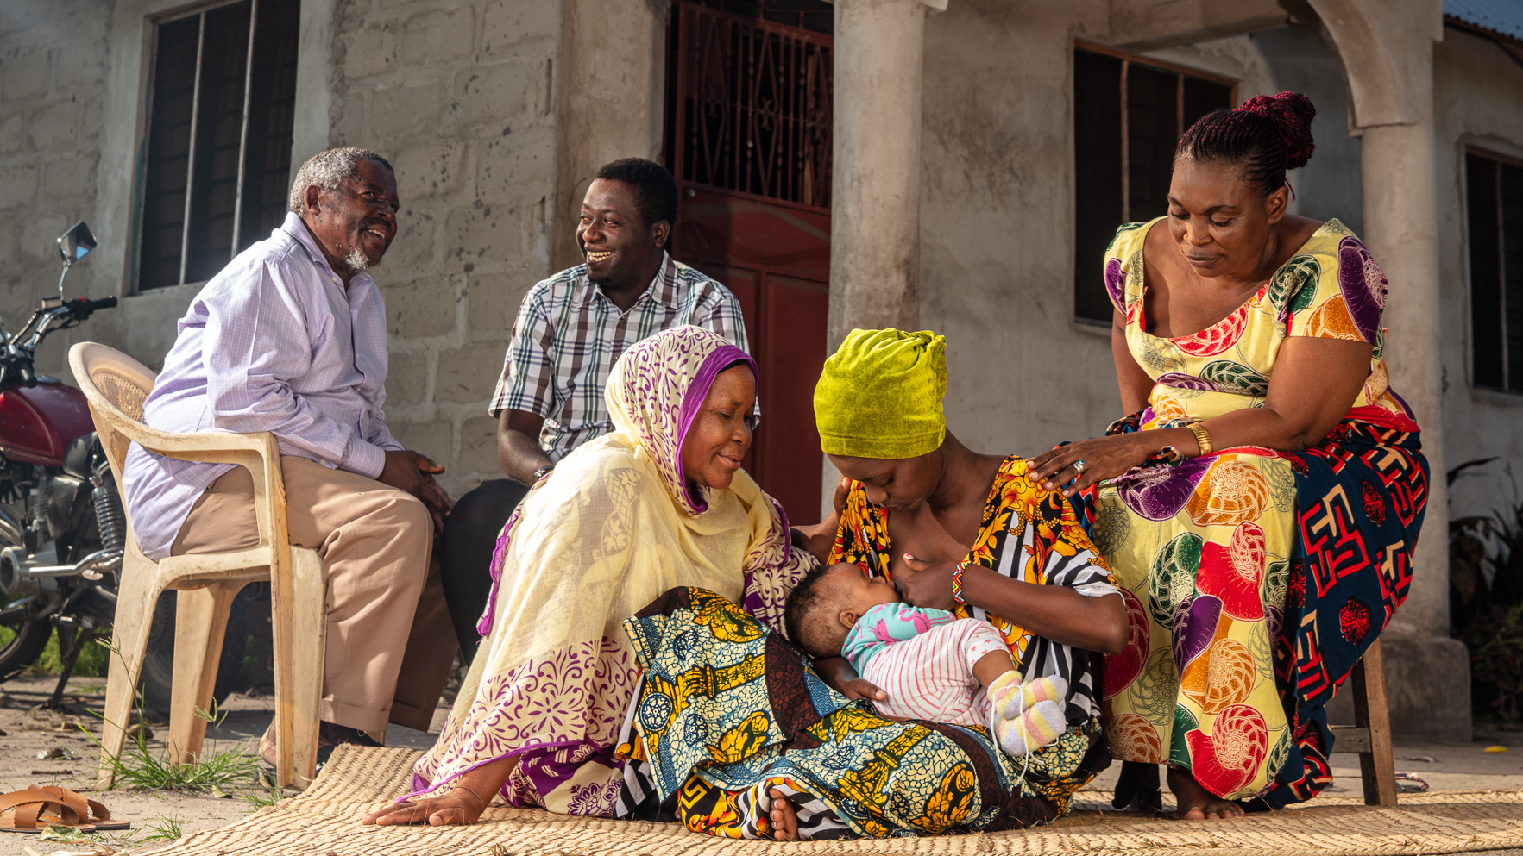

FINAL
CAMPAIGN MATERIALS- RADIO DRAMA

Slide 2

MTOTO WAKO NI WETU SOTE | RADIO DRAMAS
EPISODE 1 – Introduction & BF “On Demand”
ANNOUNCER: Welcome to the KAKA NA DADA BARAZA
ANNOUNCER: Karibu kwenye KAKA NA DADA BARAZA
Makame: Dear fellow ‘Kaka na Dada’.
Makame: ‘Wapendwa Kaka na Dada’
Subira: Yes Big Bro!
Subira: Tuambie kaka mkubwa!
Makame: Are there younger kids at your home?
Nyumbani kwenu mna mtoto alie chini ya miaka 2”
Abass: I have a 2 weeks young sis. Since her birth, dad has taken my name away from my mum. now he calls her mama Busara. But... (other kids interrupt with laughter)
Abass : Mimi nina mdogo wa kike ana wiki mbili, tangu azaliwe, baba hamuiti mama kwa jina langu tena, sasa anamuita Mama Busara. Lakini....(other kids interrupt with laughter)
Nasra: Ahaha, so sorry, I have a 2-months young bro,
Nasra: Ahaha, pole, mimi nina mdogo wa kiume ana miezi miwili,
Abass: our little sis wakes up crying at night
Abass: Sema mi Mdogo wangu analia sana usiku

Slide 3
MTOTO WAKO NI WETU SOTE | RADIO DRAMAS
EPISODE 1 – Cont’d
Subira: Yeah, that’s drives me crazy, but grandma says Mom needs to feed him whenever he is hungry, “on demand”, to be sure he gets enough.
Subira: “Kweli hata mdogo wangu analia sana, lakini Bibi alisema Mama anatakiwa kumnyonyesha mdogo wangu kila mara anapohitaji ili akue vizuri”
Abass: What does “on demand” mean?
Abass: ‘’ Anapohitaji’’ inamaanisha nini?
Nasra: It means, whenever your baby sister starts to cry or presses her mouth or fusses, your mom needs to breastfeed her, even if she just fed.
Nasra: -Inamaanisha kumnyonyesha mtoto kila anapoonesha dalili yoyote ya kutaka kunyonya ikiwemo kuweka vidole mdomoni,kuanza kulia na kupiga miayo muda wote wa usiku na mchana hata kama ametoka kunyonya muda mfupi uliopita
Abass: OK, will endure that.
Abass: Sawa, inabidi nivumilie tu
Makame: We’ll end by saying that for babies under 2, you are required to do the 2. Today we learned about the first one – exclusive breastfeeding for the first six months.
Makame: Tumalizie leo kwa kusema, kwa watoto chini ya miaka 2 unapaswa kufanya mawili. Leo tumeongelea Unyonyeshaji wa maziwa ya mama pekee kwa miezi 6 ya mwanzo.
Announcer: Don’t miss the next Kaka na Dada Baraza to learn what you need know about being an older brother or sister.
Announcer: Usikose Kaka na Dada Baraza ijayo ujifunze kuhusu kuwa kaka na dada mkubwa

Slide 4
MTOTO WAKO NI WETU SOTE | REVISED RADIO DRAMAS
AMENDED EPISODE 1 – Cont’d
Subira: Yeah, that’s drives me crazy, but grandma said the reason why he is crying he might be hungry, Mom needs to feed him whenever he is hungry, “on demand”, to be sure he gets enough.
Subira: kweli hata mdogo wangu huwa analia sana, lakini Bibi alisema akilia huenda akawa na njaa, hivyo Mama anatakiwa kumnyonyesha kila mara anapohitaji ili akue vizuri”
Abass: What does “on demand” mean?
Abass: ‘’ Anapohitaji’’ inamaanisha nini?
Nasra: It means, whenever your baby sister starts to cry or presses her mouth or fusses, your mom needs to breastfeed her, even if she just fed.
Nasra: -Inamaanisha kumnyonyesha mtoto kila anapoonesha dalili yoyote ya kutaka kunyonya ikiwemo kuweka vidole mdomoni,kuanza kulia na kupiga mihayo muda wote wa usiku na mchana hata kama ametoka kunyonya muda mfupi uliopita
Abass: OK, will endure that.
Abass: Sawa, inabidi nivumilie tu
Makame: We’ll end by saying that for babies under 2, you are required to do the 2. Today we learned about the first one – exclusive breastfeeding for the first six months.
Makame: Tumalizie leo kwa kusema, kwa watoto chini ya miaka 2 unapaswa kufanya mawili. Leo tumeongelea Unyonyeshaji wa maziwa ya mama pekee kwa miezi 6 ya mwanzo.
Announcer: Don’t miss the next Kaka na Dada Baraza to learn what you need know about being an older brother or sister.
Announcer: Usikose Kaka na Dada Baraza ijayo ujifunze kuhusu kuwa kaka na dada mkubwa

Slide 5
MTOTO WAKO NI WETU SOTE | RADIO DRAMAS
EPISODE 4 – Balanced Diet
ANNOUNCER: Welcome to another edition of the KAKA NA DADA BARAZA
ANNOUNCER: Karibu kwenye toleo lingine la KAKA NA DADA BARAZA
Makame: Dear fellow ‘Kaka na Dada’.
Makame: Wapendwa ‘Kaka na Dada’.
Subira: Present, Big Bro!
Subira: Ndio kaka mkubwa!
Blessing: mmh.. Apart from David’s 7 months old brother Anyone have a slightly older brother?
Blessing:Mhhh.. Tofauti na mdogo wake David wa miezi 7. Kuna mwenye dogo mkubwa kidogo?
Nasra: Yeah, my sister just turned 1 year.
Nasra : Ndio Mdogo wangu ana mwaka mmoja
Abass: what do you feed her?
Abass: Huwa analishwa nini?
Blessing: mom tries to mix for her different food at different times. She says it’s important to give her a “balanced meal.”
Blessing: Mama anajitahidi kumpa vyakula vya aina mbalimbali. Anasema ni muhimu mtoto kulishwa mlo kamili.

Slide 6
MTOTO WAKO NI WETU SOTE | RADIO DRAMAS
EPISODE 4 – Cont’d
Nasrah: Hold up… That’s the 2nd B in the do the 2Bs! But what do you mean by a “balanced meal”?
Nasrah: Ngoja kwanza...unamaanisha nini unaposema mlo kamili’?
Blessing: My auntie explained that basically… its variety of foods to give our bodies & brains energy, especially growing babies.
Blessing: Shangazi alitueleza kwamba...ni mchanganyiko wa vyakula vya aina mbalimbali vinavyohitajika na miili yetu na hasa kwa watoto wanaokua”
.
Subira: Huh! I love paja la kuku and I’d be happy to eat that all day every day and nothing else.
Subira: …”Hee, ninavyopenda paja la kuku, ningefurahi kula kila siku na sio kitu kingine chochote”
Blessing: Hahaha! You need to balance it up. Have a little paja la kuku, some ugali, some mchicha, and a piece of pawpaw, that’s a balanced meal.
Blessing: Hahaha! Inabidi uchanganye paja la kuku kidogo,ugali,mchicha, kipande cha papai
Makame: Ok, we get it! That’s the 2nd B “balanced meal” for kids 6-24 months as breastfeeding is continued.
Makame: Ok, Tumeelewa! Hilo ndio jambo la pili ‘ Mlo Kamili’’ kwa watoto wa miezi 6-24 huku wakiendelea kunyonyeshwa
Announcer: Don’t miss the next Kaka na Dada Baraza to learn more on what you need know about being an older brother or sister.
Announcer: Usikose Kaka na Dada Baraza ijayo ujifunze kuhusu kuwa kaka na dada mkubwa.

Slide 7
MTOTO WAKO NI WETU SOTE | RADIO DRAMAS
EPISODE 5 – Enriching Uji
ANNOUNCER: Welcome to another edition of the KAKA NA DADA BARAZA
ANNOUNCER: Karibu katika toleo lingine la KAKA NA DADA BARAZA
Makame: Dear fellow ‘Kaka na Dada’.
Makame: Wapendwa ‘Kaka na Dada’.
Abbas: Present, Big Bro!
Subira: Ndio kaka mkubwa!
Subira: I have a question on last time’s “balanced meal”. My 8 months little sister eats a lot of uji, I was wondering how can I add variety to uji?
Subira: Nina swali kuhusu ‘mlo kamili’ tuliojifunza mara ya mwisho. Mdogo wangu wa miezi 8 anakunywa sana uji, najiuliza ni jinsi gani naweza kuufanya uji kuwa mlo kamili??
Blessing: ooh I have seen my mom pounding up groundnuts, adds it and boiled vegetables like carrots and green pepper to the uji along with a little milk. She says its super healthy for babies.
Blessing: Ohh, nimemuona mama yangu akiongeza karanga zilizosagwa, karoti, pilipili hoho na maziwa kwenye uji wa mdogo wangu. Mama aliniambia uji wa namna hii ni mzuri zaidi kwa afya ya mtoto.”

Slide 8
MTOTO WAKO NI WETU SOTE | RADIO DRAMAS
EPISODE 5 – Cont’d
Subira: must taste great
Subira: Lazima una ladha nzuri
Blessing: Yap, my little brother gobbles it up.
Blesing: Haswaa, Mdogo wangu anafakamia chote
Subira: Great, I’m going to suggest it to my mom. Thanks for the tip!
Subira: Kumbe, na mimi nitaenda kumshauri mama. Asante kwa kunijuza
Makame: yea lets help our little sister get her 2nd B – give a balanced diet from 6-24 months See you next time.
Makame: Ndio tumsaidie mdogo wetu kupata jambo la pili – Mpe Mlo kamili kuanzia miezi 6-24, bila kusahau kuendelelea kumnyonyesha maziwa ya Mama. Tukutane wakati mwingine.
Announcer: Don’t miss the next Kaka na Dada Baraza to learn more on what you need know about being an older brother or sister.
Announcer: Usikose Kaka na Dada Baraza ijayo ujifunze kuhusu kuwa kaka na dada mkubwa

